Slide 1

2013 In Review

Slide 2




Slide 3

Costar Technologies Sales
2001- 2013 14.4% CAGR
CohuHD
Acquisition
6-3-14
Major Retail Rollout
Economic

Slide 4

Security Market
ASIS International and IOFM Study Finds U.S. Security Industry to be $350 Billion Market.
IHS Study says the security market grew by 10.8% in 2013. Consolidation appears to be premature, with the top 15 manufacturers accounting for only 22% of the overall market.
According to a new whitepaper from IHS, the global market for video surveillance equipment is expected to grow by more than 12 percent in 2014. In fact, the market research firm is forecasting that revenues this year will rise to nearly $16 billion, up from $14 billion in 2013. Market revenues are expected to top more than $20 billion in 2017.
Source: SECURITYINFOWATCH.COM

Slide 5

Security Market
Early
Driver
Mid-and-large sized systems from 32-plus up to thousands of cameras per system have been leading the transition to IP. A major growth opportunity for IP is evolving as the small system market of 16 cameras or less per site are adopting IP. Key issues for these smaller installations are price, retaining existing analog, and easy to install, and easy to set up.
Companies that offer IP products that are easy to install, easy to operate, easy to maintain, retain analog while providing the flexibility of switching out pieces of a system while moving forward into the new technology, will see great success.
Easy to Install
Easy to Operate

Slide 6

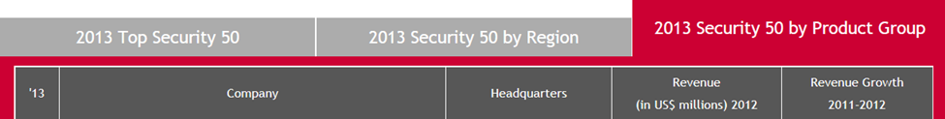
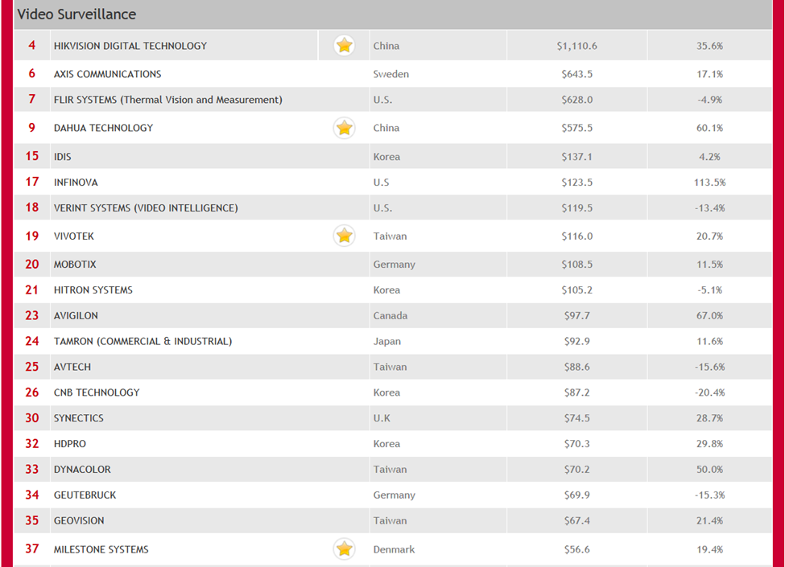
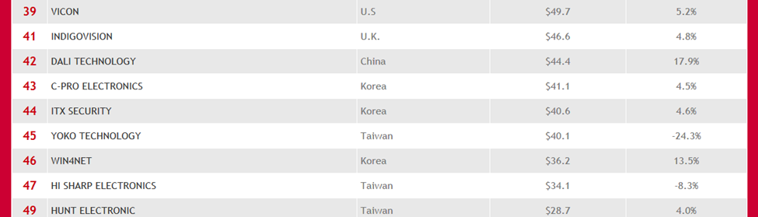
Security Market
#42 > $44M
Source: www.asmag.com

Slide 7


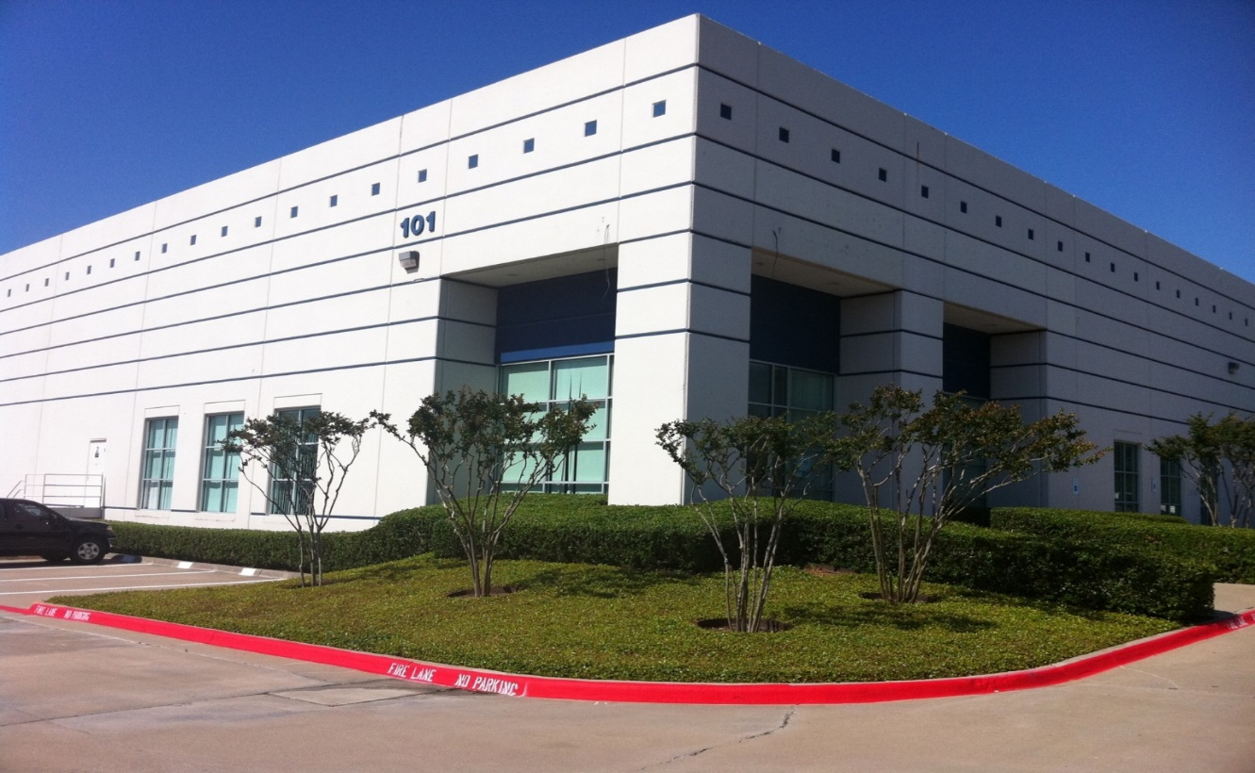
Headquarters in Coppell, Texas

Slide 8
Revenue
16.3 % CAGR
2011 - 2013
35.2%
13.3%
16.1%

Slide 9
SG & A
24.0%
25.5%
21.1%

Slide 10
Gross Profit Margin
32.4%
29.0%
28.2%
24.2%

Slide 11
Net Income
7.2%
3.0%
0.9 %

Slide 12
2011 - 2013
Variance
Year
2013
2012
2011
Revenues $ 26.48 M
Gross Margin $ 7.47 M
GM % 28.2 %
Operating Expenses $ 5.60 M
Oper Exp % 21.1 %
Operating Income $ 1.87 M
Int/Inc/Taxes ($ 0.04 M)
Net Income/Loss $1.91 M
$ 19.58 M
$ 5.67 M
29.0 %
$ 4.99 M
25.5 %
$ 0. 68 M
$ 0.09 M
$ 0.59 M
$ 17.34 M
$ 4.20 M
24.2 %
$ 4.16M
24.0 %
$ 0.04 M
($ 0.12 M)
$ 0.16 M
35.2 %
31.7 %
12.2 %
175 %
224 %

Slide 13
Product Market
Revenues
Market Acceptance
Initial Market
Time

Slide 14
Network Product Sales
607 % CAGR
2011 - 2013

Slide 15
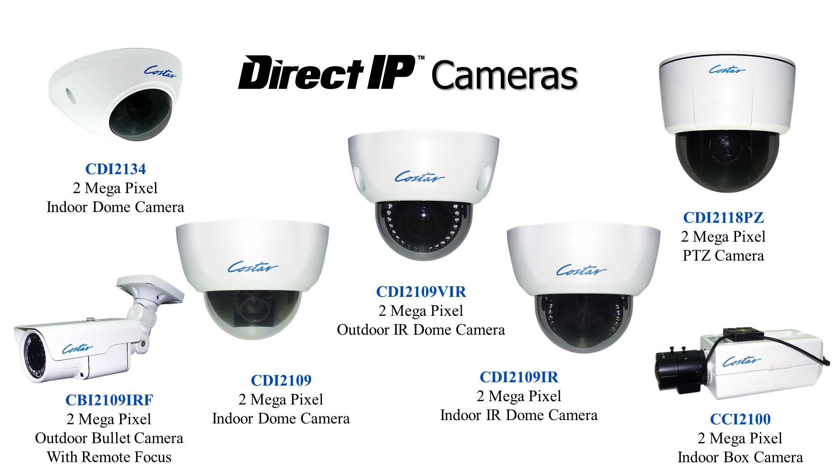
IP Cameras

Slide 16
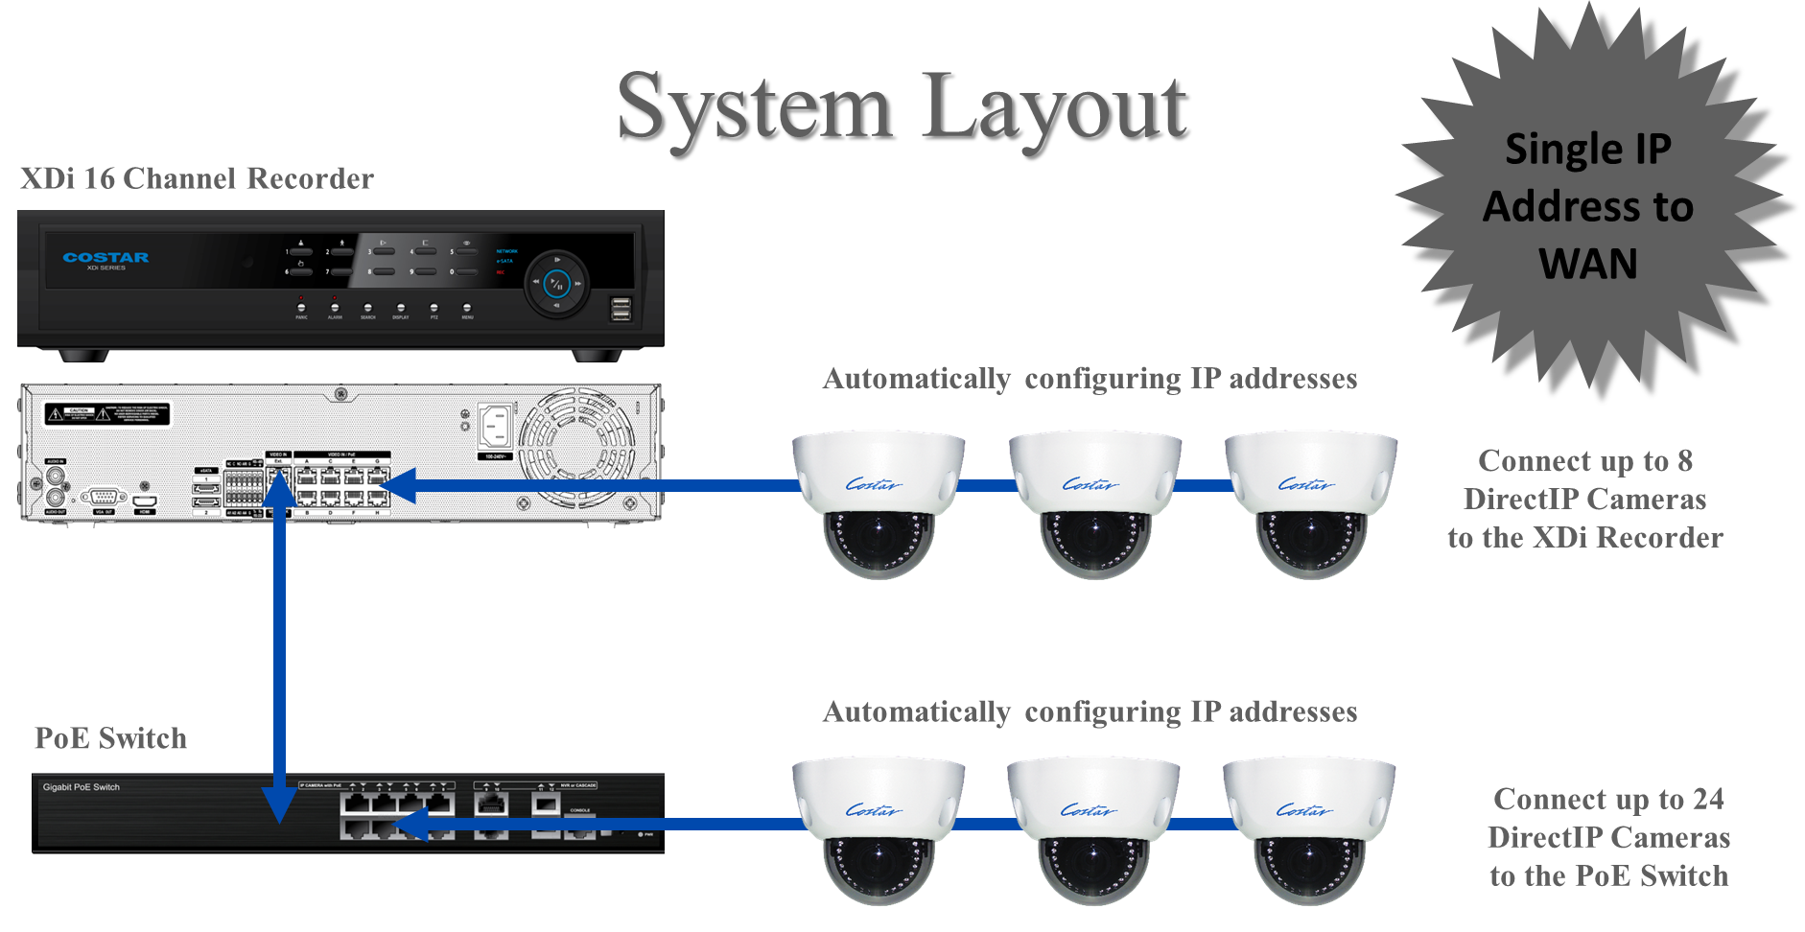
Direct IP Recorder

Slide 17

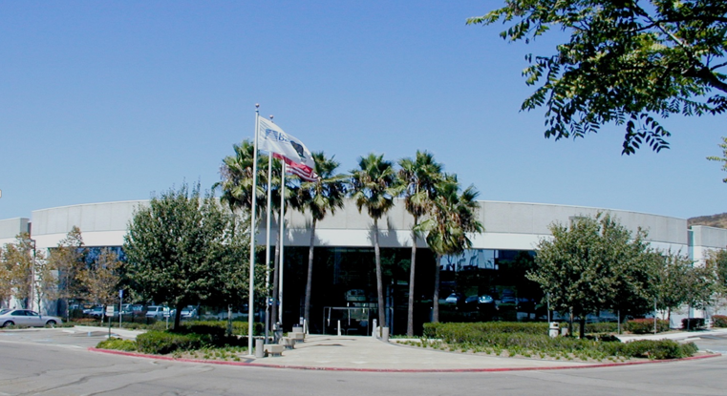
Facility in Poway, California
Acquired June 6, 2014

Slide 18


CohuHD is a leading manufacturer of video surveillance camera systems for use in mission-critical, sensitive environments. Integrating the latest video compression and High Definition IP technology into its innovative, rugged video camera systems. Cohu’s line of high quality HD cameras and management software can be found on the international space station, monitoring the busiest freeways and ports, military bases, U.S. Navy ships, oil refineries, nuclear reactors, mines, and other critical installations around the globe.

Slide 19

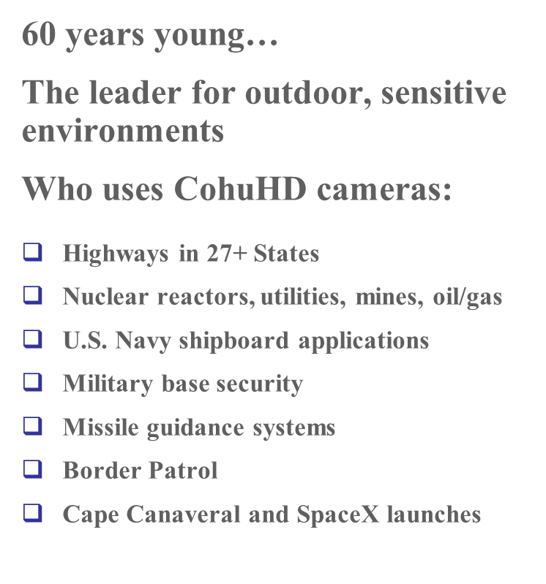
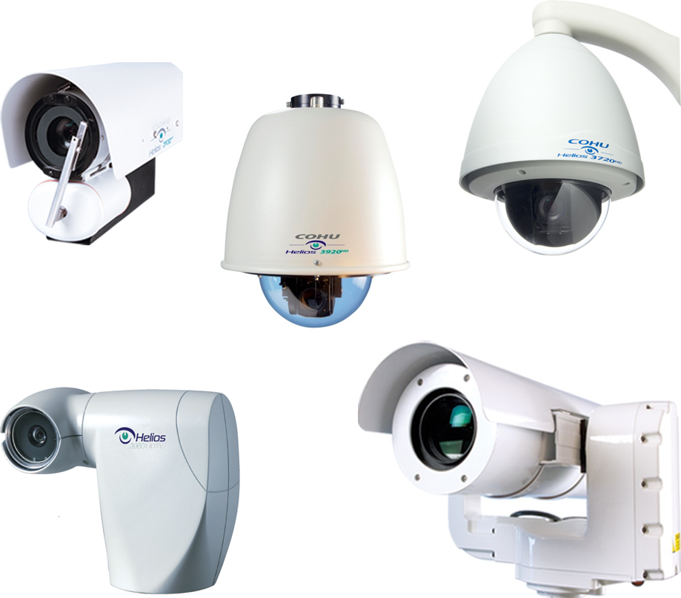

Slide 20

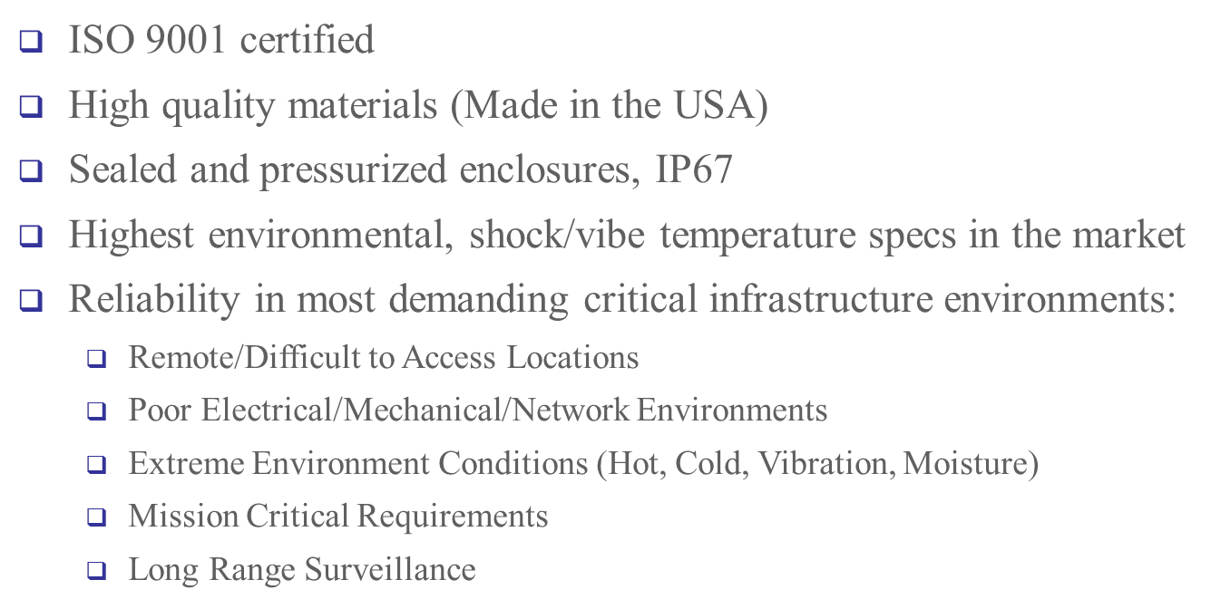

Slide 21
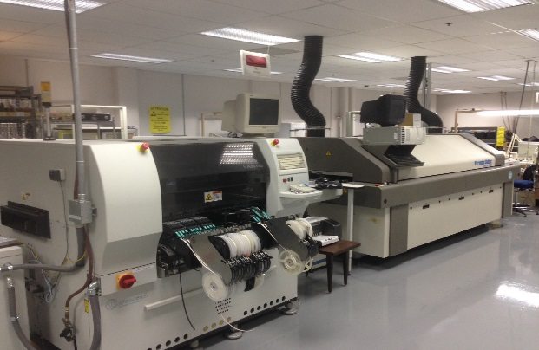
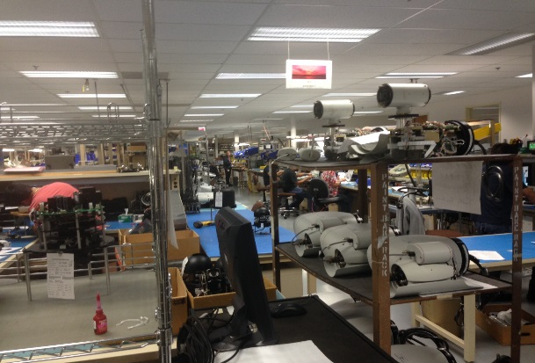
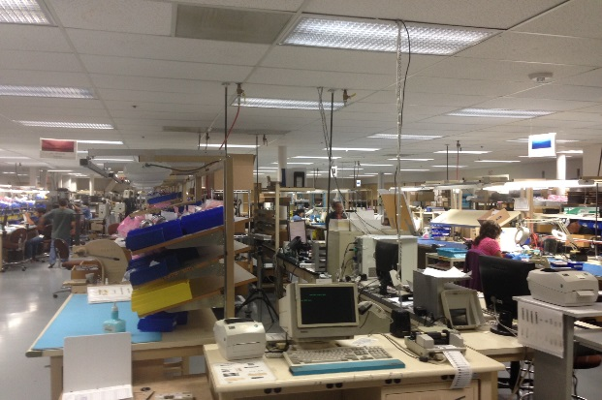
CohuHD Facility
SMT and Wave Flow
Soldering Machines
Demand Flow
Technology Production Line
Demand Flow
Technology Production Line

Slide 22
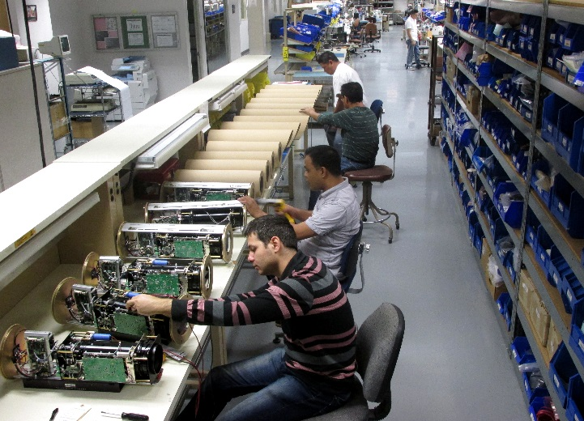
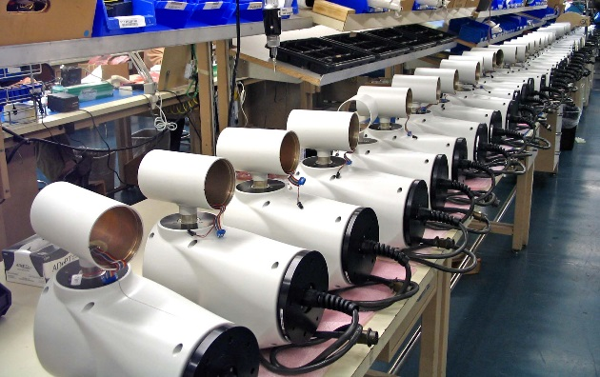
CohuHD Facility
Demand Flow
Technology Production Line
Demand Flow
Technology Production Line

Slide 23
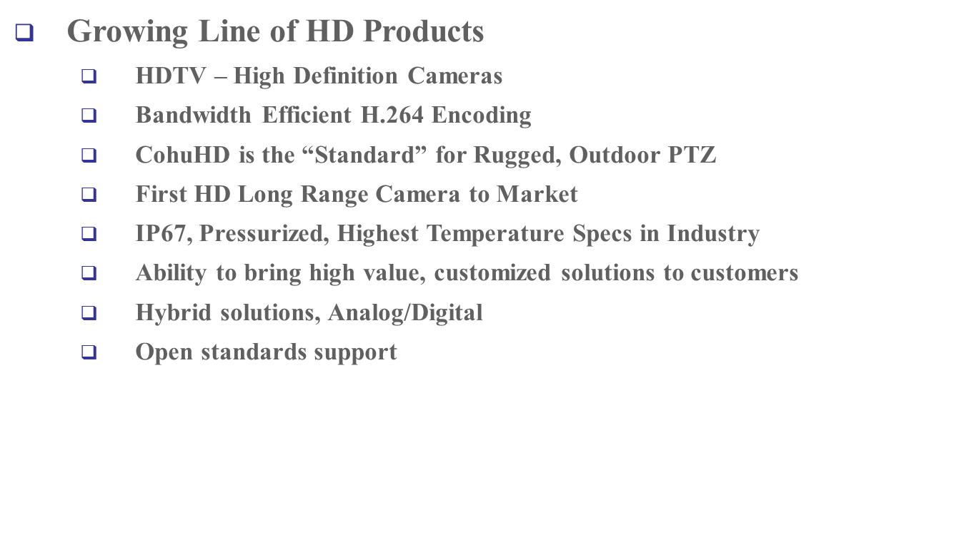
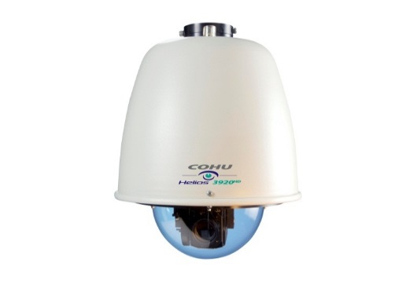
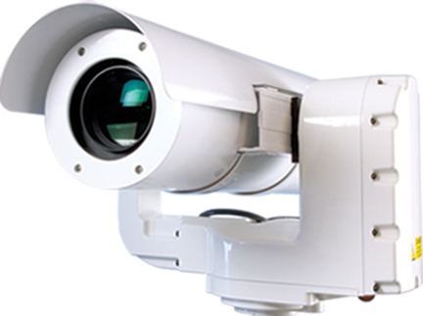
CohuHD

Slide 24
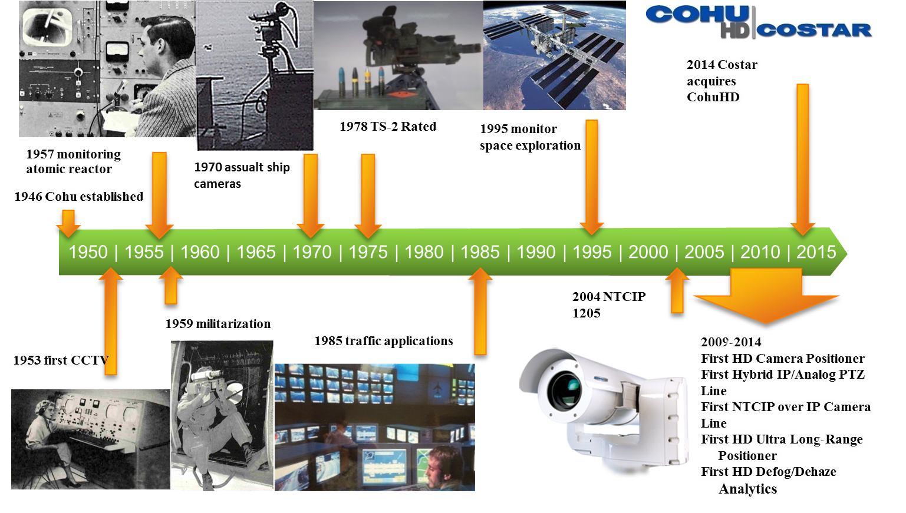
CohuHD Firsts

Slide 25
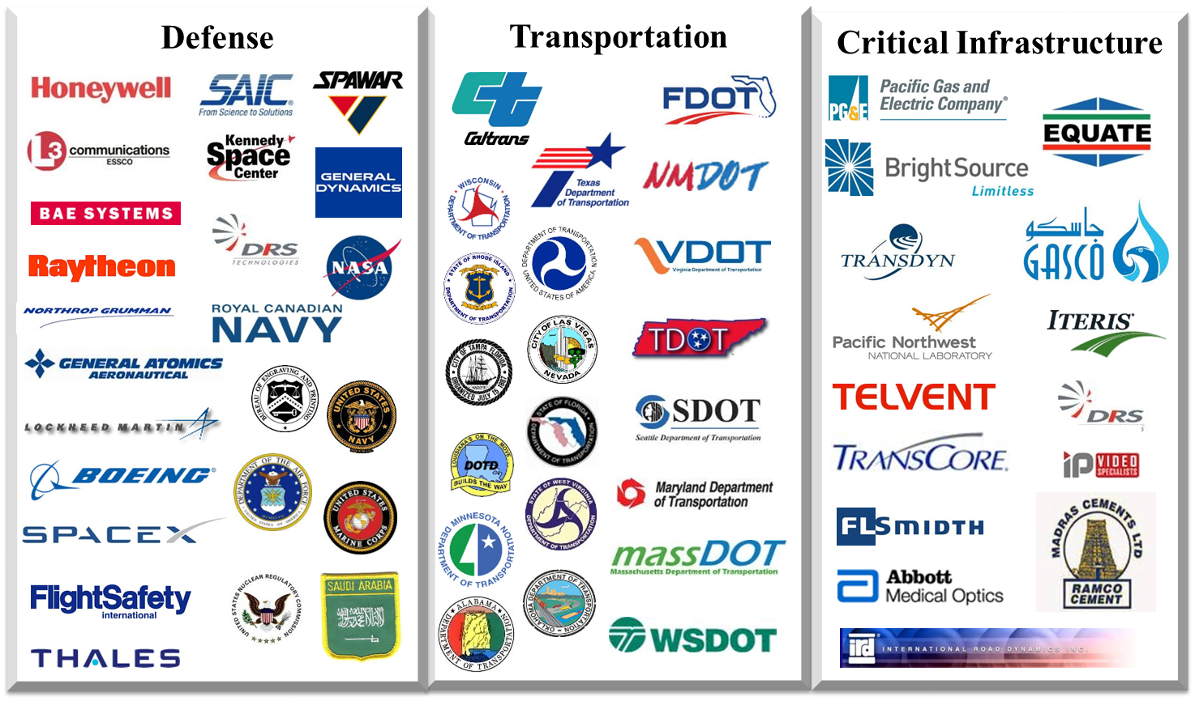
CohuHD Customers

Slide 26

CohuHD Installations

Slide 27
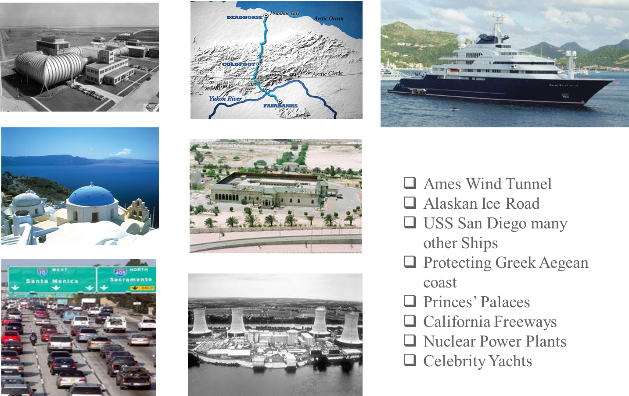
CohuHD Installations

Slide 28
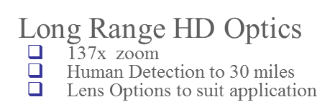

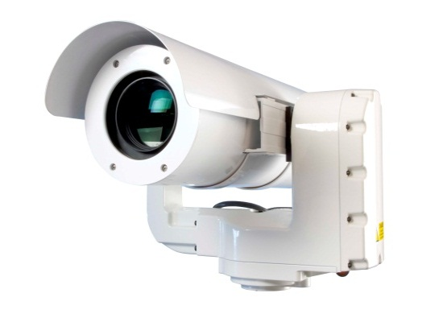
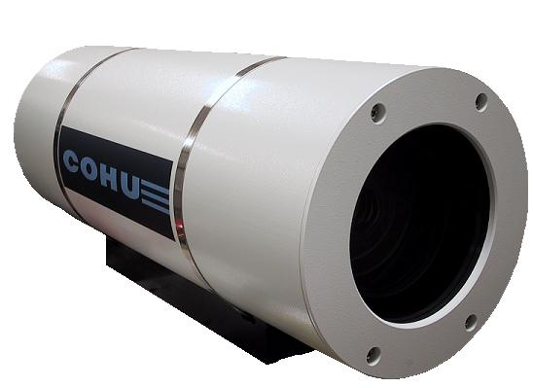
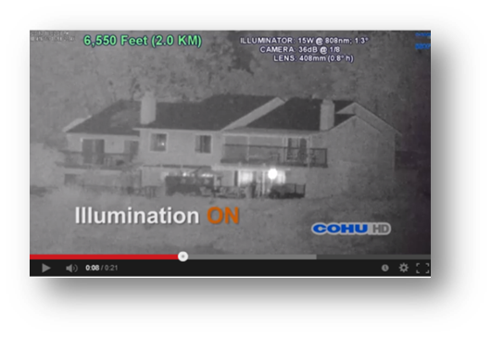
CohuHD
808nm Laser Illumination at 2Km

Slide 29
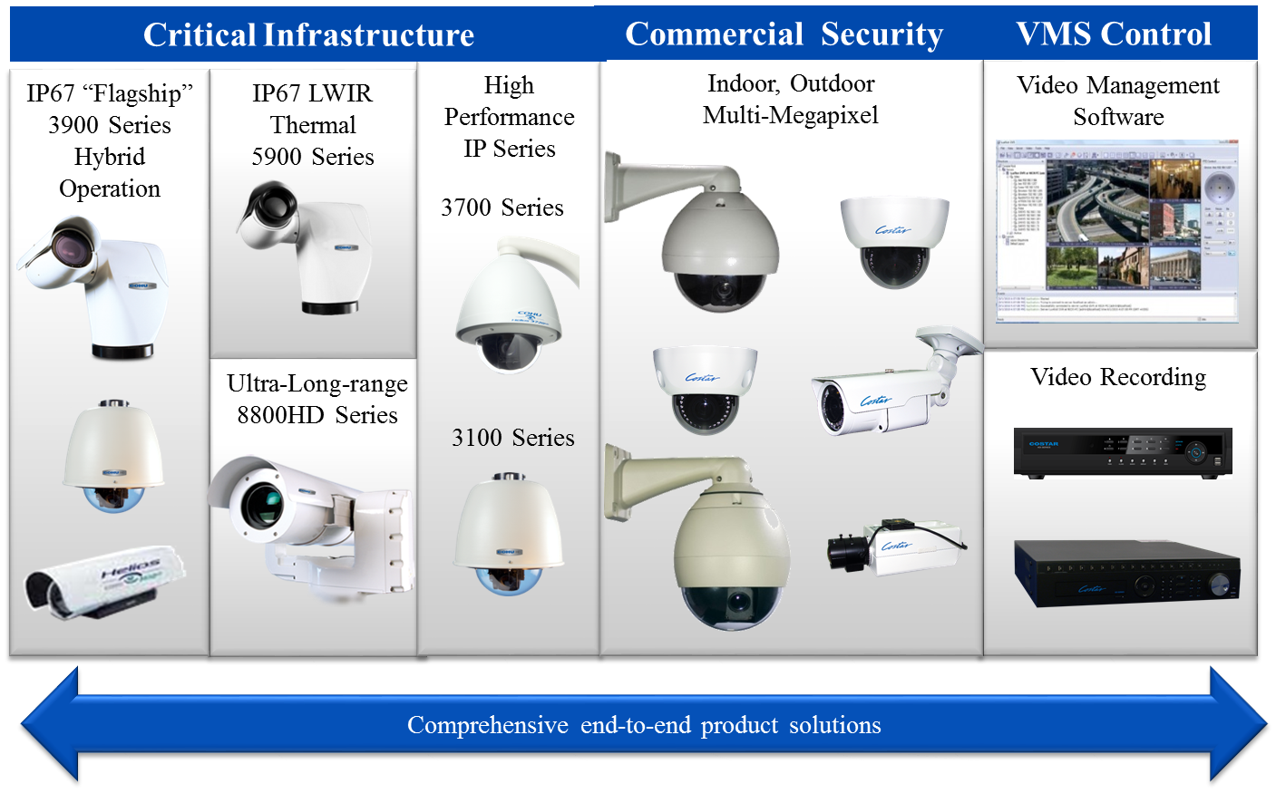
Complete Product Solutions

